Slide 1

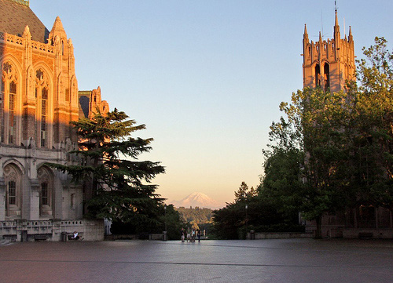
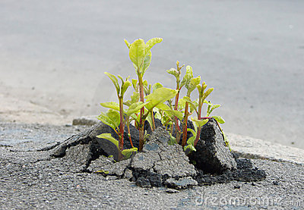
Data Science Incubator Fall 2014
ß

Slide 2
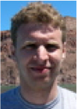

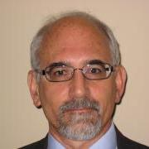
Introductions — Data Science Liaisons
Daniel Halperin — Director of Research, Scalable Data Analytics
Bill Howe — Associate Director, eScience Inst.
In absentia:
Andrew Whitaker — Data Scientist
Jake VanderPlas — Dir. Res., Physical Sciences
Joe Hellerstein — Senior Data Scientist

Slide 3
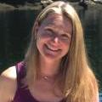

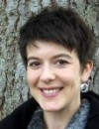
Introductions — cont.
eScience Program Managers
Micaela Parker
Sarah Stone
DSE Ethnography team
Brittany Fiore-Silvfast
et al.

Slide 4
eScience Project Leads
Andrew Becker (Astronomy), Jake & Dan
Ângela Katsuyama (Biology), Bill & Dan
Carlos A. Manzanares (Economics), Andrew
Emily Gade (Political science), Dan & Andrew
Matthew Denes (Finance & Business Econ.), Andrew
Sophie Clayton (Oceanography), Dan

Slide 5





A 5-year, $37.8 million cross-institutional collaboration

Slide 6
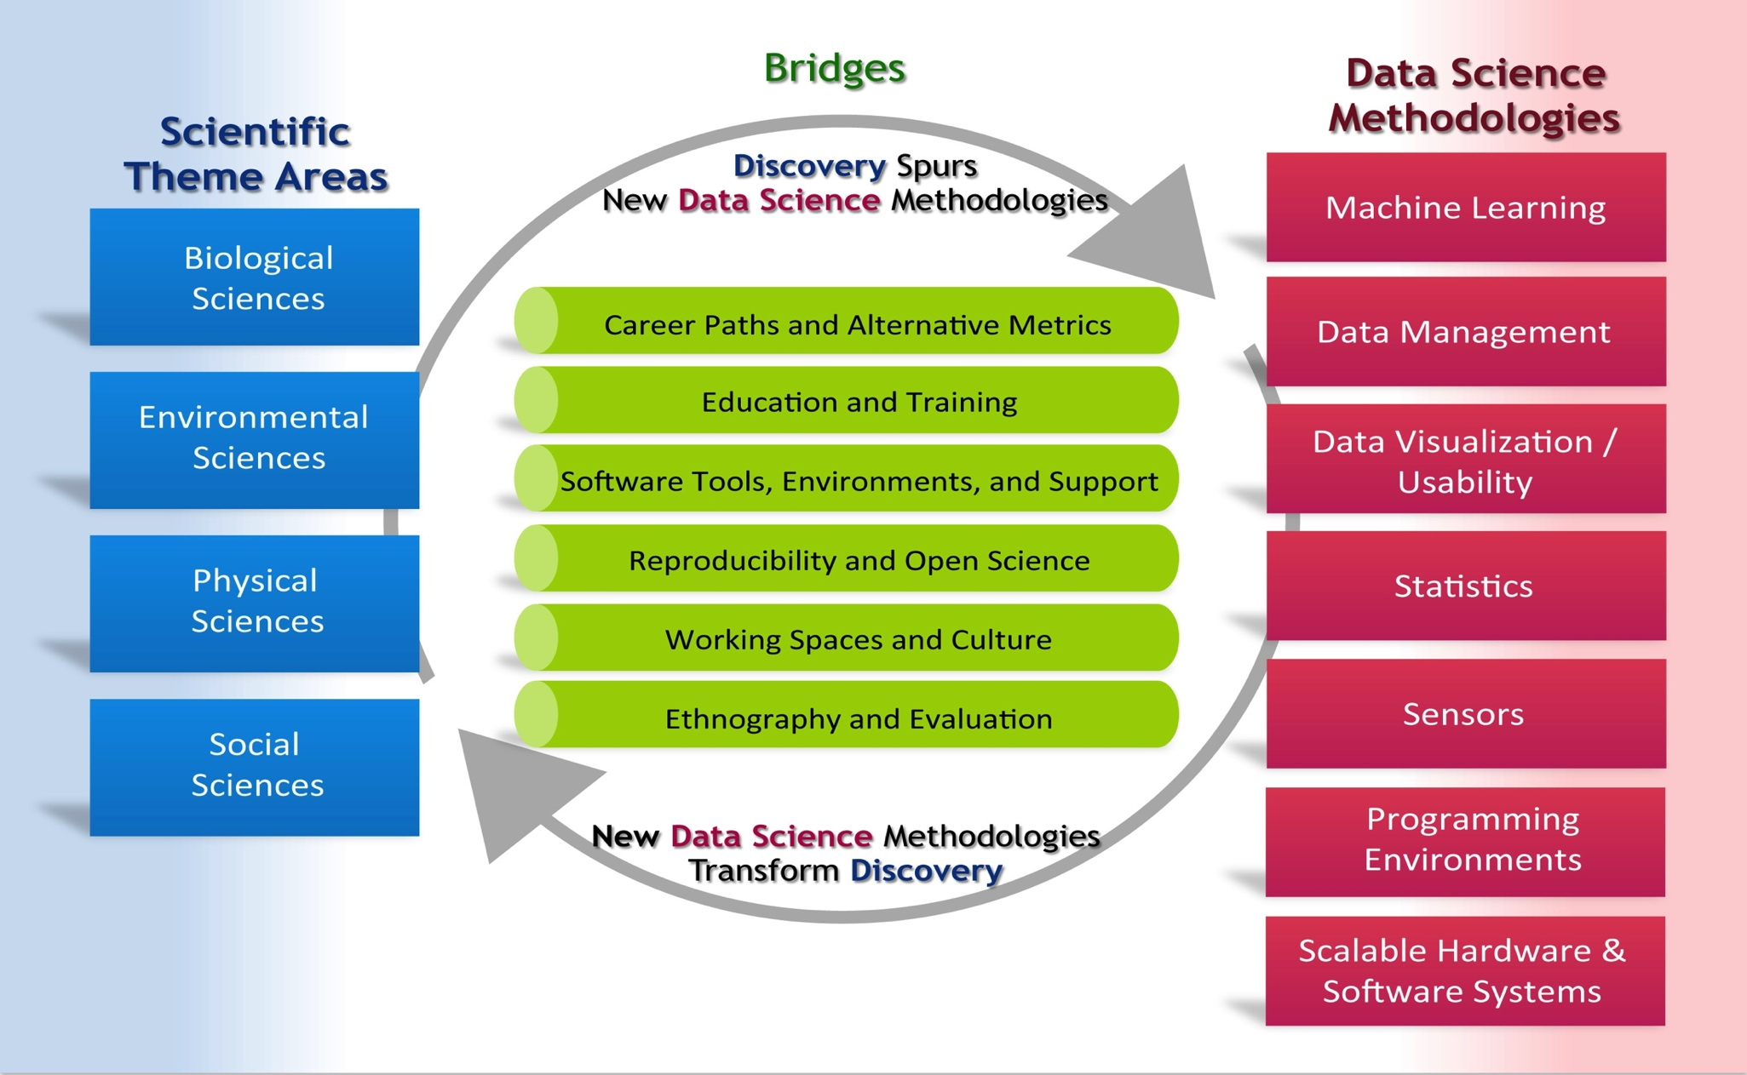

Establish a virtuous cycle
6 working groups, each with
3-6 faculty from each institution

Slide 7
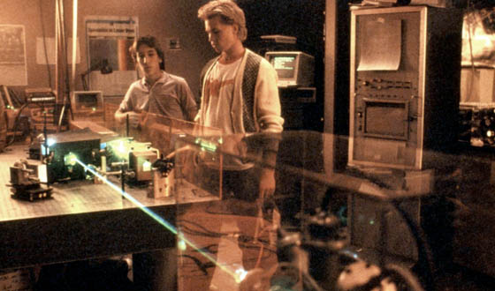
This is an experiment!
Our goals
Help advance new directions in data-intensive science
Reinforce and expand the eScience collaboration network
Gather requirements for new tools and infrasructure
Collect and publish success stories
A strategy
Increase casual technical interaction – optimize for attention span
Improve access to mutual expertise
Focus on short time scales and “small bets”
Borrow ideas from commercial software development
“We’re making this up!”
Feedback & ideas extremely welcome!

Slide 8
Logistics (1) – Scheduling
“Incubator Days” are Tuesdays and Thursdays
Ad hoc technical interaction, and therefore physical proximity, is pretty central to this experiment
We’re assuming that everyone can work effectively here
Naïve assumption is that laptops + UW wireless access + remote resources is sufficient
Printer! (Fax, phone?)
So we ask that your “home base” be the incubator on these days (but of course we will all have meetings, classes, etc.)
Continuous block of time more valuable than “hour here, hour there” – goal: 4+ hour block on each day

Slide 9
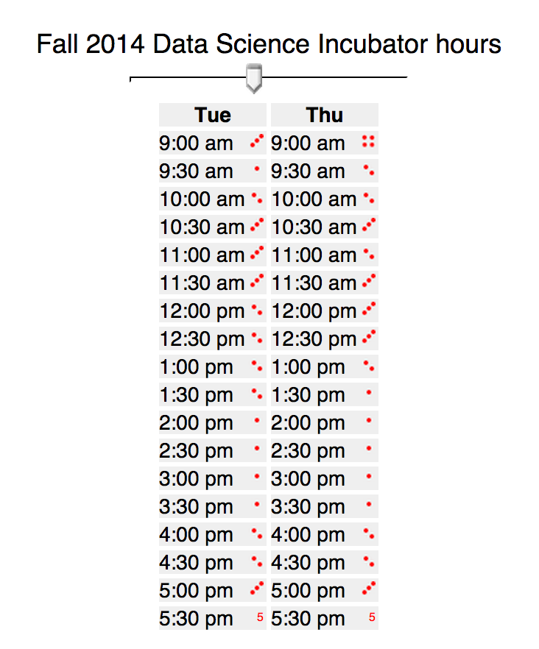
Scheduling
Your intersection, at right
Incubator staff, most days ~9−6
You will have 24/7 access (Husky card Sieg, key Studio)
Printed calendar for travel

Slide 10
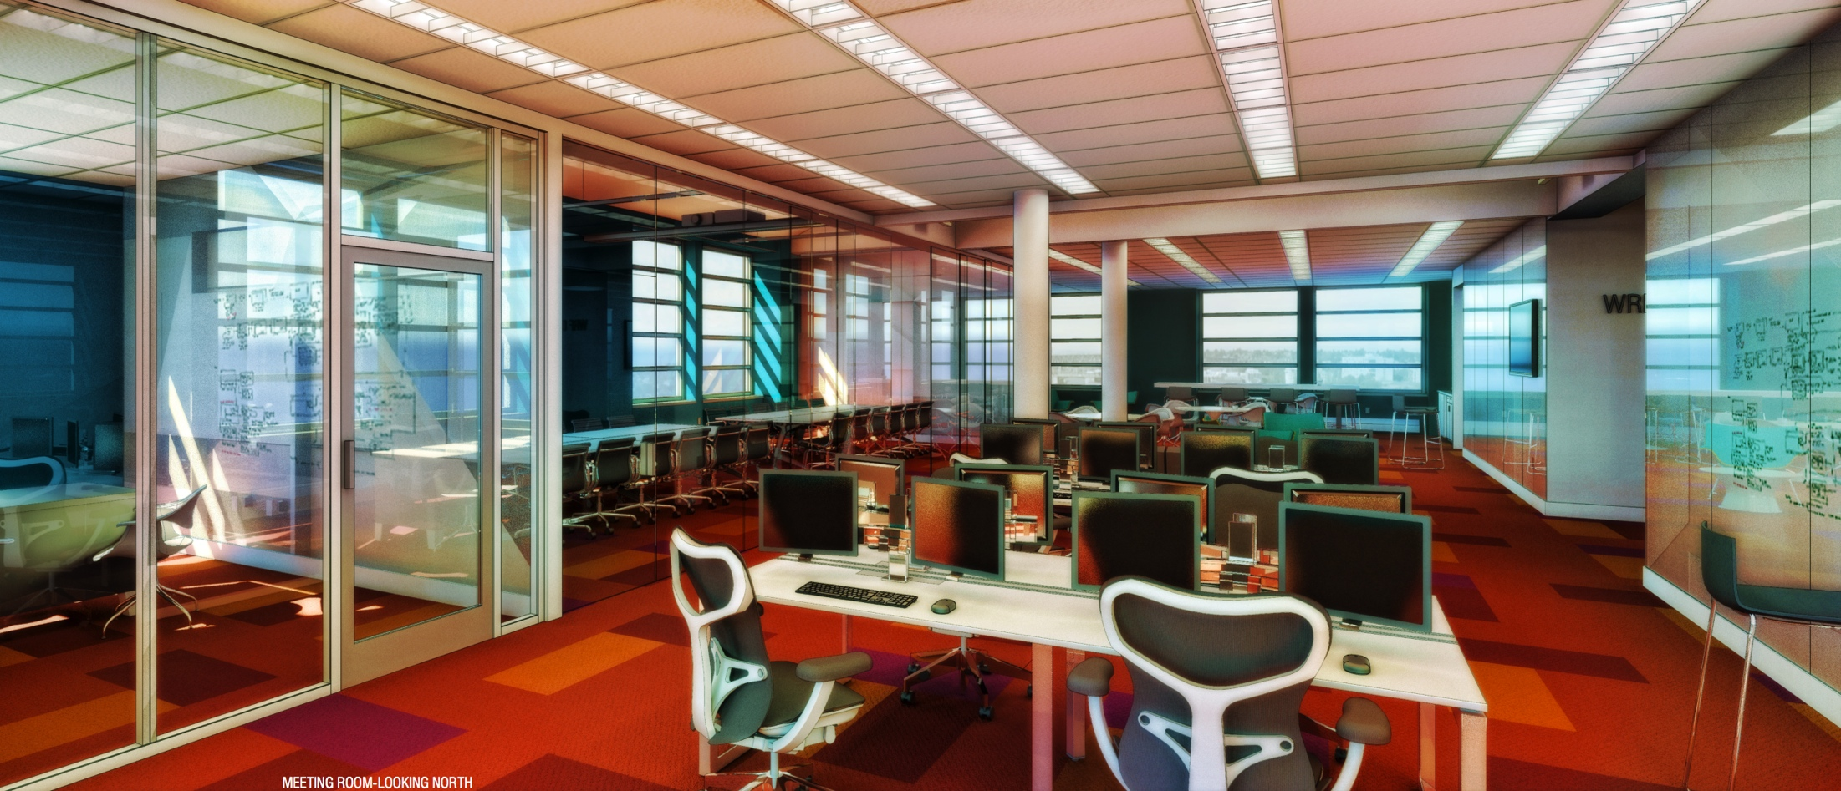
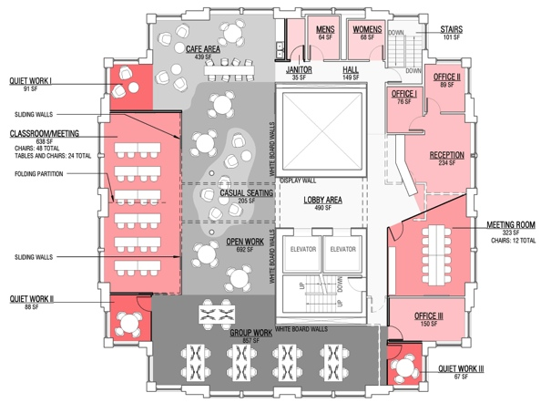
Data Science Studio
Opening October 27, 2014

Slide 11
Logistics (2) – Code and computing
We will use GitHub for all projects
Through eScience, GitHub sponsors our private repos
But the default expectation is that code will eventually be released open source through permissive open source licenses
We’ll get accounts set up in a few minutes
Andrew will lead a tutorial on Thursday
eScience can facilitate access to data management and compute services
SQLShare for small-to-medium sized tabular data
Myria, Hadoop, Database, Spark in CSE
Compute and storage on campus (Hyak and lolo)
Amazon, Google, and/or Microsoft cloud services

Slide 12
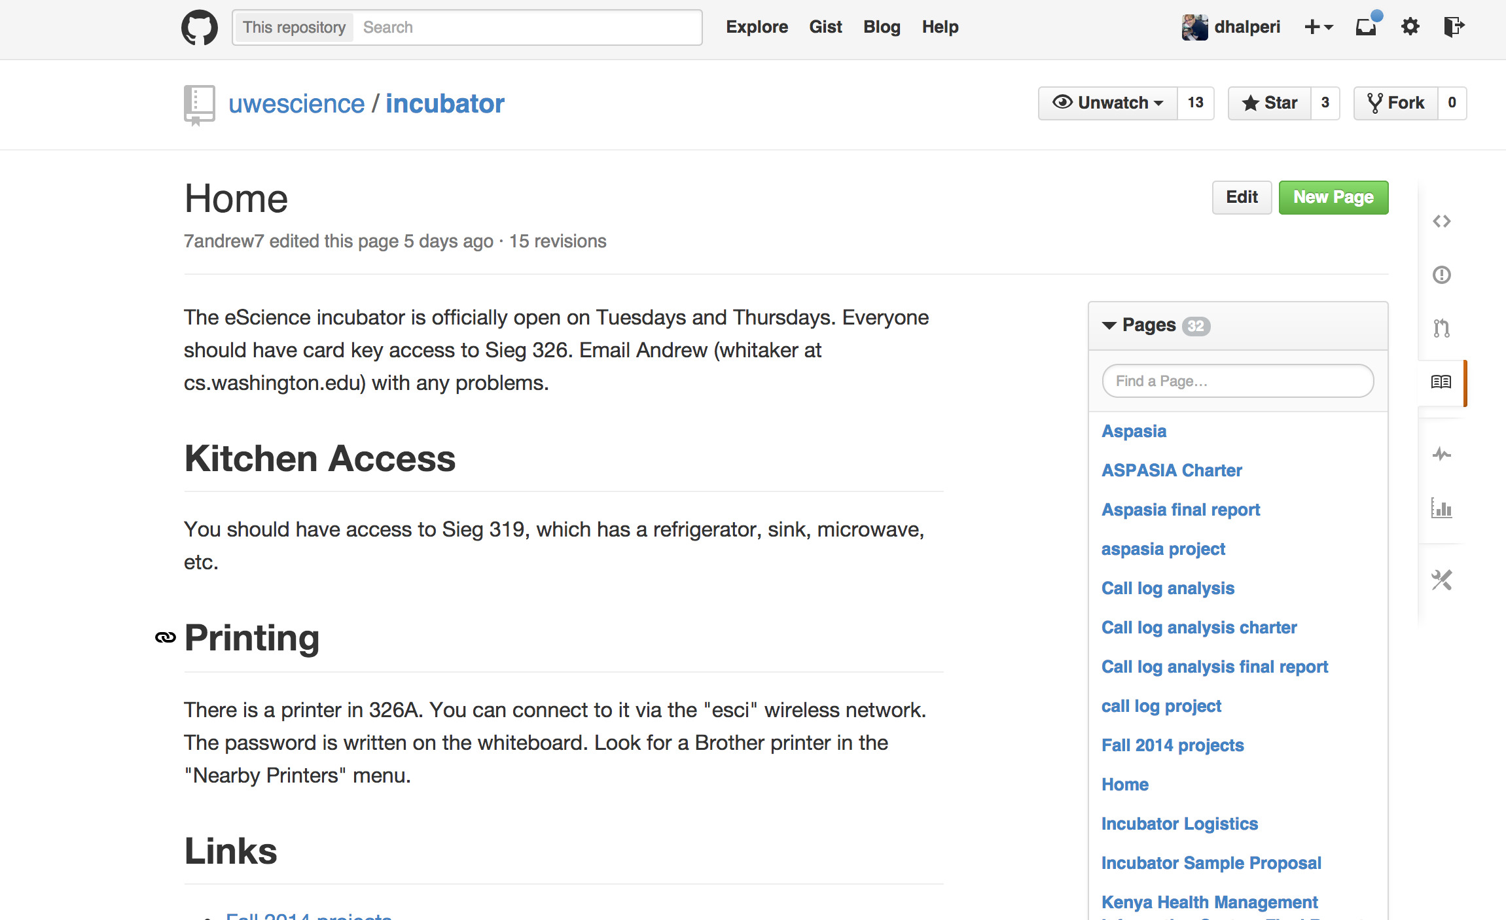
GitHub Wiki for Incubator
https://github.com/uwescience/incubator/wiki

Slide 13
Logistics (3) – Communicating / reporting
(Remember: This is an experiment!)
In spring, we had 3 large milestones/write-ups
Beginning: charter
Midterm milestone & report
Final milestone & report & presentation
Impression: bad fit. (Reports too heavyweight, milestones not well aligned)
In spring, not as much project-project communication as we wanted

Slide 14
Logistics (3b) – Communicating / reporting
(Remember: This is an experiment!)
New plan for Fall 2014
Incubator daily (2/wk) micro-blogs (“Hogg-style”)
Demo: hoggresearch.blogspot.com
Demo: pelican blog platform, blog.halper.in
Weekly 1–2 minute group updates (“standup”)
Today: project intros
Generally: try to have some demo/visual (github?)

Slide 15
Logistics (3c) – Communicating / reporting
(Remember: This is an experiment!)
It’s hard to scope incubator projects (+ charter & milestones)
Define and work towards “3 levels of success”
“minimum” – if we do not accomplish this, we’ve failed
“expected” – this is what we think we can do
“stretch” – it would be awesome if we could do this
We expect (& hope?) some projects continue

Slide 16
Incubator project intros

Slide 18


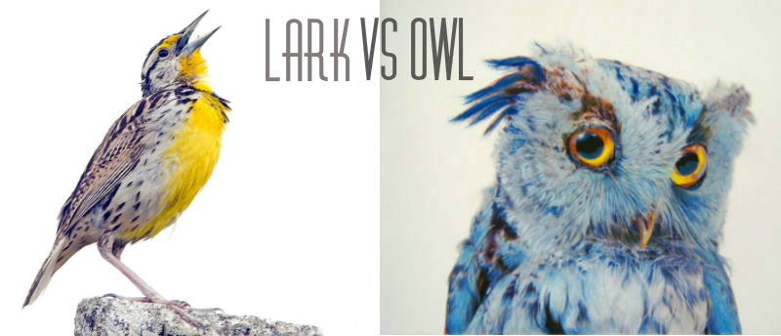


Students' sleep and academic performance
Ângela
Katsumaya
(Biology)
Data from:
1)
Example:
Actiwatch
2)
Sleep Diary
3)
Example
(output):
Chronotype
questionnaires
Correlated to:
Activity
Grades?
Gender?
Clock time

Slide 20
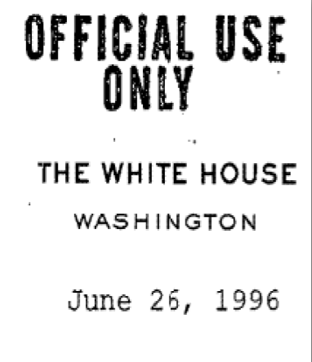
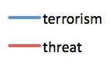
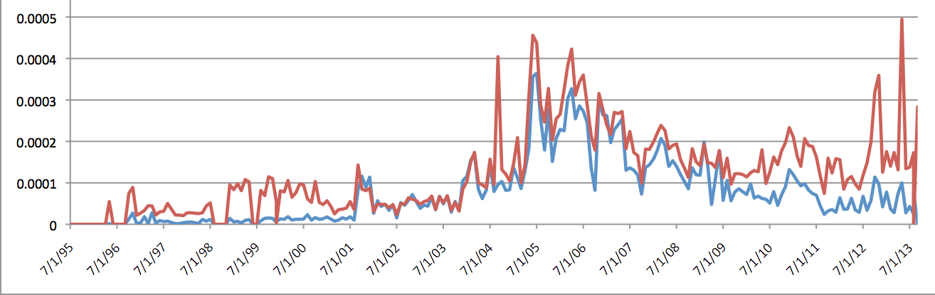

The Devil You Know: Threat Construction in the United States Emily Kalah Gade
What, in addition to terrorism, was securitized following 9/11, and how has threat construction spread since?
What is securtization?
The use of security-related political
discourse to turn a certain threat into
an existential threat for a given nation
Thesis:
Post-9/11, the global war on
terror wedged open the door for the
construction of additional threats,
and to be acceptant of those threat
constructions. We expect a
proliferation of threat uptake across
the U.S. government.
Method:
Presidential Decision Directives between 1992 and 2013
for identified threats (“Terrorism”, “North Korea”, “Deforestation”), and to construct threats (“dangerous”, “security”, “hazard”). Map spread of discourse.
Dataset:
US .gov Websites between 1995-2013, scarped using
Python and Appache Pig.
So What?
Understanding how threats are constructed, provides critical insight into how ideas move through government, the relationship between political power and idea transfer, and the role of discourse in political outcomes.
Term Frequency Across Time, All Cites
Department of Political Science

Slide 23
Todos today
Card access: Student/Employee IDs?
Schedule weekly standups (Tue, 9:45am)
Schedule demo day (Thur, Dec 4 @3:30pm)
Log travel days on wall calendar
Create GitHub accounts
Create GitHub repositories
Define 3 levels of success (“minimum”, “expected”, “stretch”) & put on project GH wiki

